Slide 1

Asurion Virtual Assistant
Saurav Chatterjee | Scott Hutter | Dhiraj Dudeja
Asurion Research Labs | July 2016
Asurion Internal Use Only

Slide 2






=
The Paradigm Shift
PC
Smart Phones
Messaging
Websites
Apps
Bots
Asurion Internal Use Only

Slide 3

=
AVA Project
Natural language processing and machine learning based bot that uses conversational dialogue to pinpoint the consumer’s tech support issues and provides a step-by-step solution path to resolve the issue. Use for pre-sales guidance, set-up help, and tech support questions. Provide a superior customer experience by providing personalized solutions, 24/7, over any channel; minimize friction using device telemetry and analytics.
Asurion
Virtual
Assistant
Asurion Internal Use Only

Slide 4

=
Why NLP Bot for Asurion?
17.2
Current manual Soluto solution won’t scale:
Want 85+% subscriber engagement
Will require 40x – 400x the number of agents
Reduce expenses for claims:
50+% of web traffic requires live agent help
Reduce training for live agents:
Need to support many more device types
More part-time agents
Benefit Customers:
24/7 support for simple questions
Connected Devices Per Household
6.8
2015
2020
Asurion Internal Use Only

Slide 5












=Television
Asurion Virtual Agent (AVA) Scope
Personalized
“Contextual Response”
Knowledge Base
Ubiquitous
“Bot parseable, agent/consumer accessible, responsive”
“Tech support available where customer is”
Intelligent Bot Engine
Hybrid
“Quick, accurate response, no friction, at customers place and time”
“Human agent always available if wanted”
Asurion Internal Use Only

Slide 6
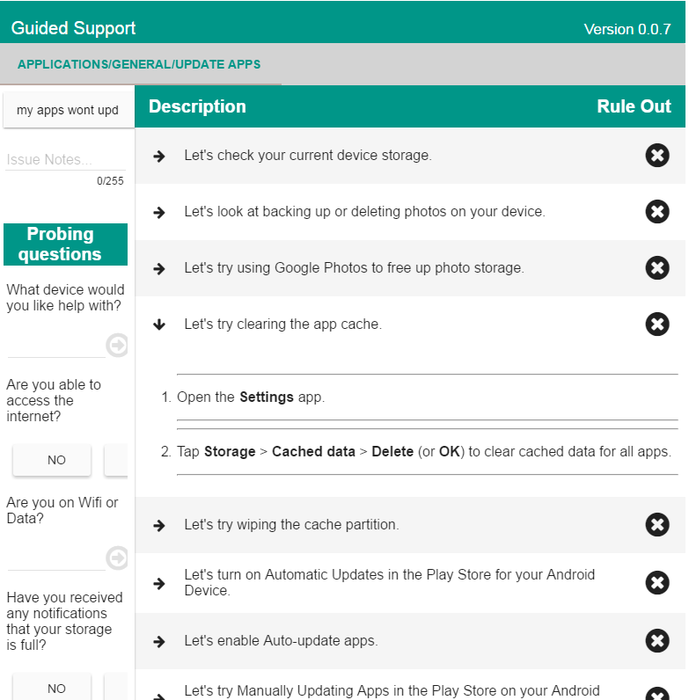
=
NLP-based Guided Support
Re-imagine search
Natural language to understand problem
Probing questions to narrow possible solutions
Fine-grain, prescriptive solutions
Prioritize solution paths based on efficacy, analytics
Flexibility for agents
Asurion Internal Use Only

Slide 7


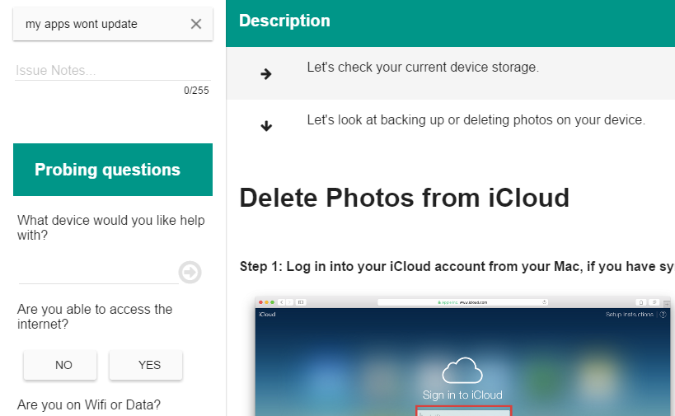
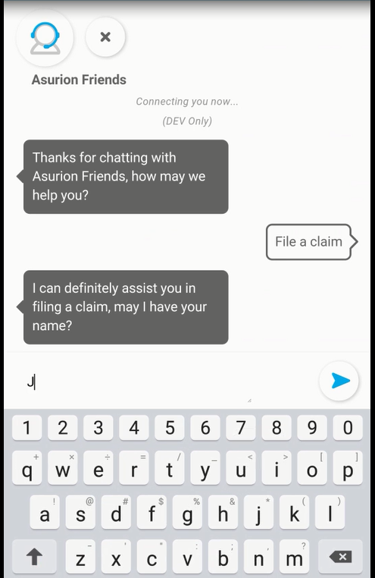
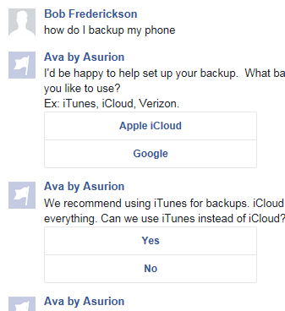
=
Modes
Agent Assisted Guided Support
Direct to Consumer (Semi) Autonomous
Asurion Internal Use Only

Slide 8
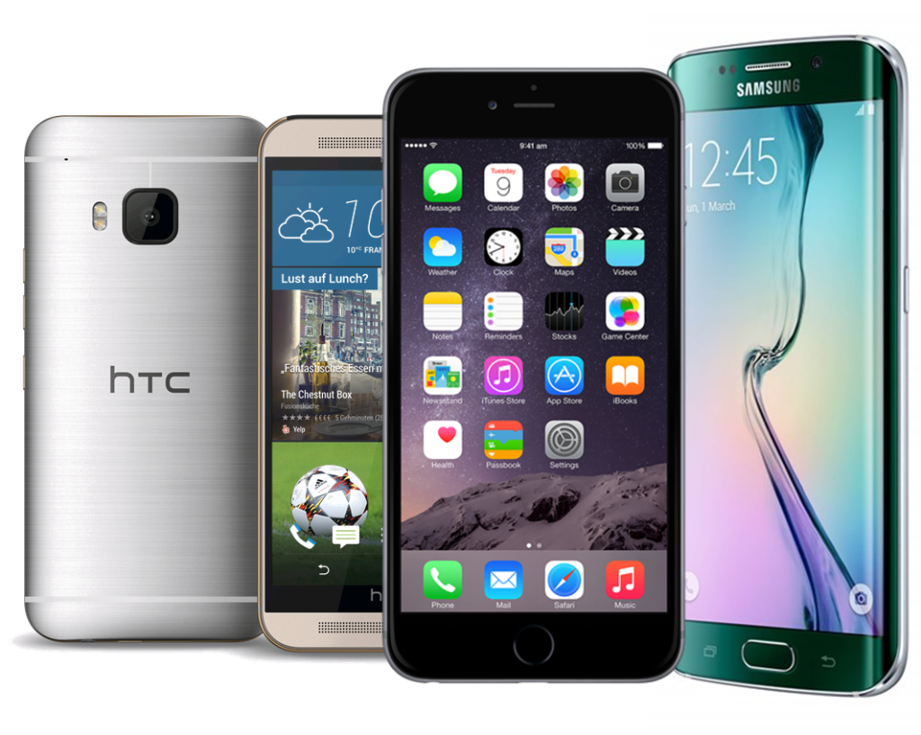

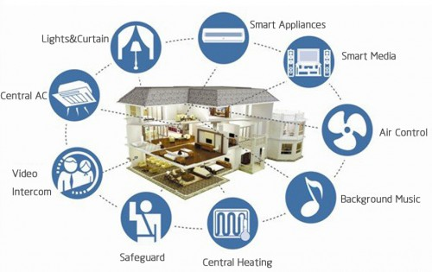
Vertical Markets
Smart Phone Support
Device Protection Claims
Smart Home Support
Sprint, AT&T, APAC
Sprint, AT&T, Verizon, Walmart
Walmart, Amazon, Sprint
24/7 support, less wait, more flexibility, consistency
+
Lower live agent CRT; more interesting problems for agents
Asurion Internal Use Only

Slide 9

DEMO
Asurion Internal Use Only

